Slide 1
Auto Pilot
Task 3

Slide 2
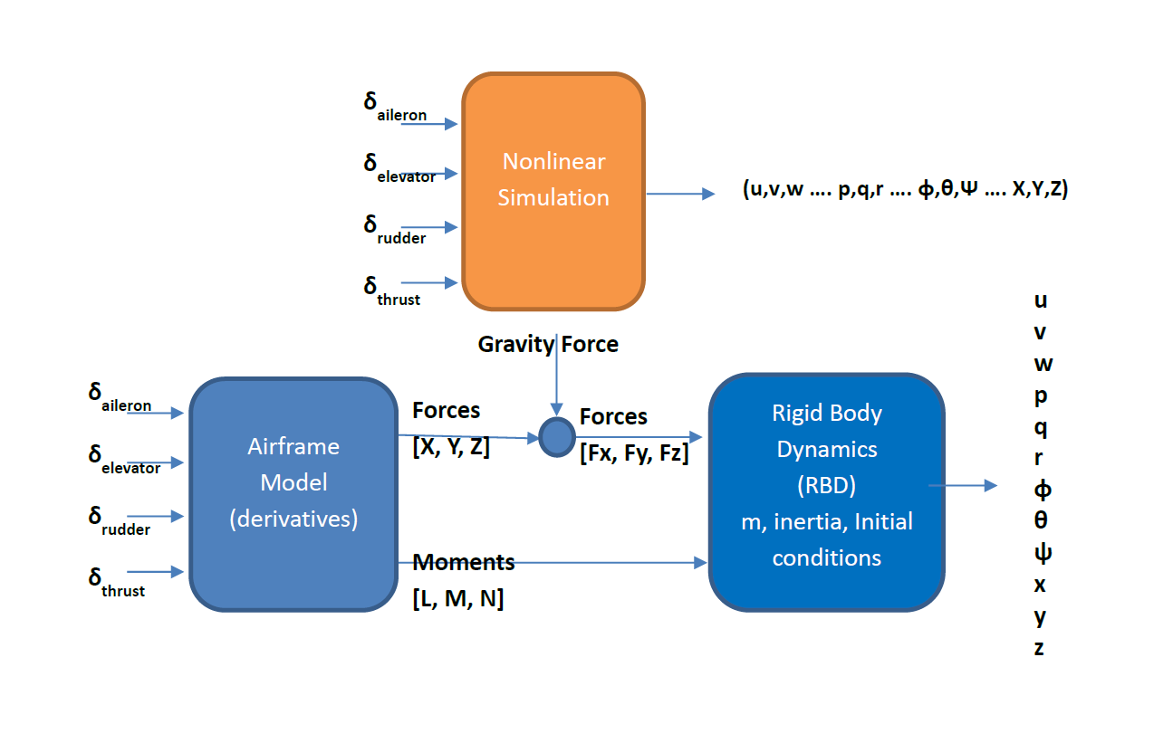



Nonlinear model
$δ_{a},δ_{e},$ $δ_{r},$ $δ_{th}$
$$F$$
States
Airframe
$$M$$
RBD

Slide 3
Forces acting on an aircraft
Thrust
Aerodynamic forces
Gravity force

Slide 4
Airframe equations
The equations describing the forces and moments acting on an aircraft are not stated analytically, that’s why we are using Taylor series expansion neglecting the higher order terms (linearizing the equations) to have an approximate description of those relations.
And that’s where we use the aircraft derivatives which can be calculated experimentally or from flight tests.

Slide 5
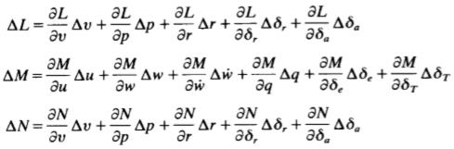

Stability derivatives $\frac{∂X}{∂u}$
Control derivatives $\frac{∂X}{∂δ_{th }}$

Slide 6
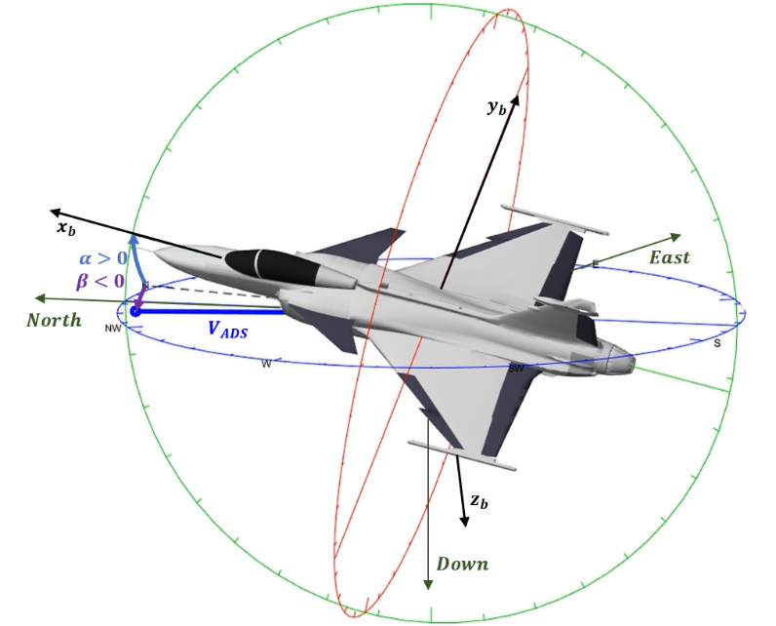

The conditions on body axis
The center of the axis coincide on the CG of the body.
X-Z plane is the plan of symmetry.
Types of body axis
Stability axis (x-axis coincide on the $V_{t}vector$).
Principle axis ($I_{xz}=0$).
Body axis (x-axis coincide on the FRL).

Slide 7
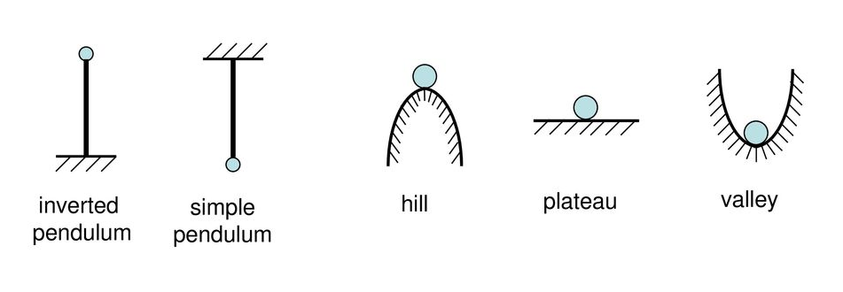
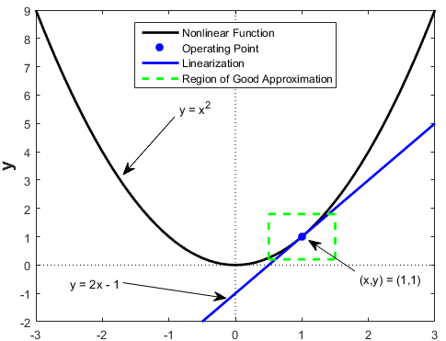
Consequences of the linearization
For the linearization to be valid with an acceptable error the perturbations must be small.
Hance we usually choose one of the equilibrium points to linearize the equations around it; Using the steady state values at the given operating condition as a reference.

Slide 8
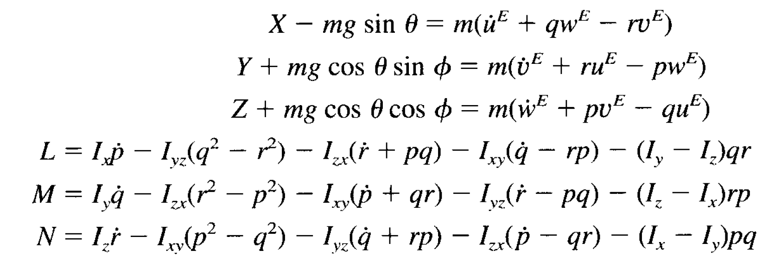
steady level flight
there is no moments acting on the aircraft.
The forces acting on the aircraft must be in equilibrium.
The rate of change of states is zero.
Forces and moments in the body axis

Slide 9
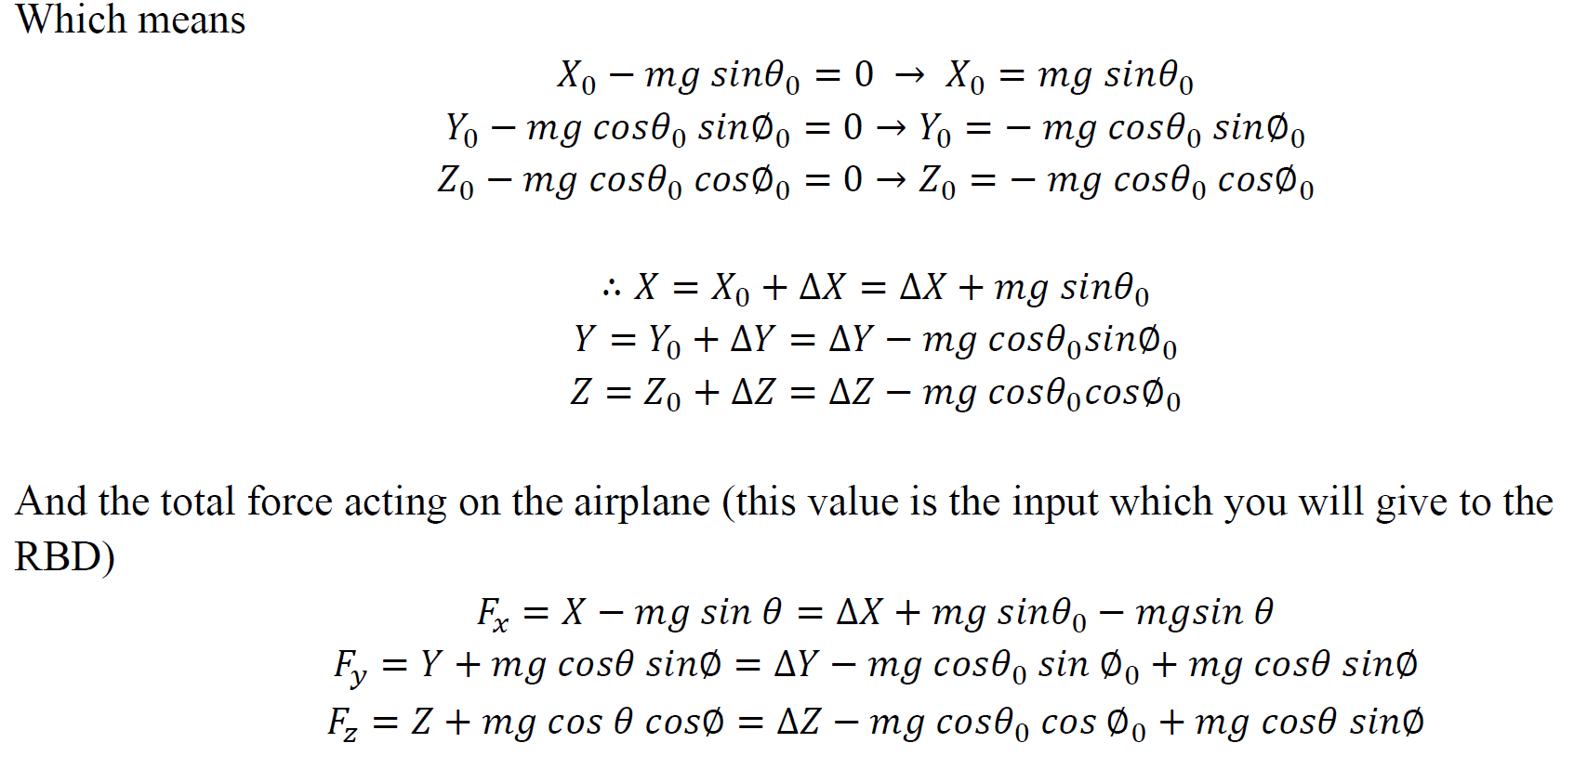
And the total force acting on the airplane Equals the vectorial sum of the aerodynamic and gravity forces.
Where$X,Y,Z$express the aerodynamic forces.

Slide 10
Thank you

